Slide 1
CS2006 Operating Systems
SPRING 2023
National University of Computer and Emerging Sciences

Slide 2
Chapter 3
Processes

Slide 3
Process Concept [1/2]
An operating system executes a variety of programs:
Batch system – jobs
Time-shared systems – user programs or tasks
Process – a program in execution, it will need certain resources—such as CPU time, memory, files, and I/O devices—to accomplish its task.
Program is passive entity, process is active; program becomes process when executable file loaded into memory
A process includes:
program counter
stack
data section

Slide 4
The Process [2/2]
Multiple parts
The program code, also called text section
Current activity including program counter, processor registers
Stack containing temporary data
Function parameters, return addresses, local variables
Data section containing global variables
Heap containing memory dynamically allocated during run time
Execution of program started via GUI mouse clicks, cmd line etc

Slide 5
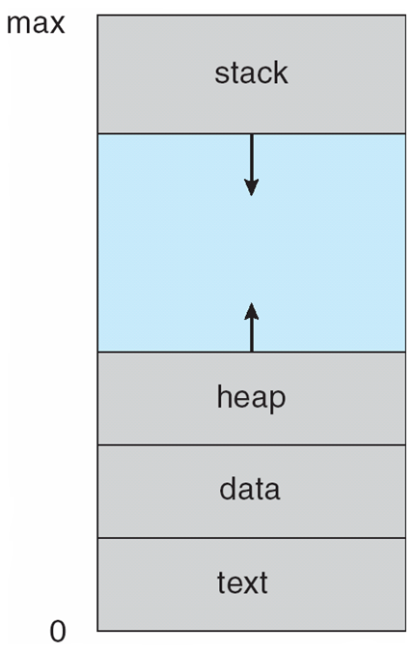
Process in Memory
Notes:
Each time a function is called, an activation record containing function parameters, local variables, and the return address is pushed onto the stack
Similarly, the heap will grow as memory is dynamically allocated, and will shrink when memory is returned to the system.
Although the stack and heap sections grow toward one another, the operating system must ensure they do not overlap

Slide 6
All multiprogramming operating systems are built around the concept of the process.
The OS must interleave the execution of multiple processes, to maximize processor utilization while providing reasonable response time.
The OS must allocate resources to processes in conformance with a specific policy (e.g., certain functions or applications are of higher priority) while at the same time avoiding deadlock.
The OS may be required to support interprocess communication and user creation of processes, both of which may aid in the structuring of applications.

Slide 7
Process State
As a process executes, it changes state
new: The process is being created
running: Instructions are being executed
waiting: The process is waiting for some event to occur
ready: The process is waiting to be assigned to a processor
terminated: The process has finished execution

Slide 8
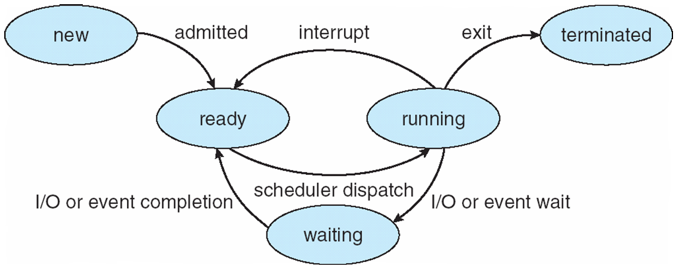
Diagram of Process State

Slide 9
At any given point in time, while the program is executing, a process can be uniquely characterized by a number of elements
identifier
state
priority
program counter
memory pointers
context data
I/O status information
accounting information

Slide 10
Identifier: A unique identifier associated with this process, to distinguish it from all other processes.
State: If the process is currently executing, it is in the running state.
Priority: Priority level relative to other processes.
Program counter: The address of the next instruction in the program to be executed.
Memory pointers: Include pointers to the program code and data associated with this process, plus any memory blocks shared with other processes.

Slide 11
Context data: These are data that are present in registers in the processor while the process is executing.
I/O status information: Includes outstanding I/O requests, I/O devices (e.g., disk drives) assigned to this process, a list of files in use by the process, and so on.
Accounting information: May include the amount of processor time and clock time used, time limits, account numbers, and so on

Slide 12
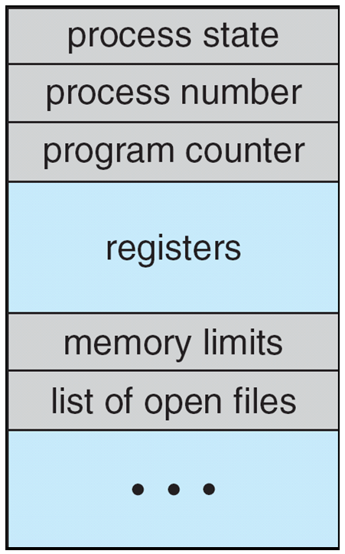
Process Control Block (PCB)
Information associated with each process also called task control block)
Process state – running, waiting, etc
Program counter – location of instruction to next execute
CPU registers – contents of all process-centric registers
CPU scheduling information- priorities, scheduling queue pointers
Memory-management information – memory allocated to the process
Accounting information – CPU used, clock time elapsed since start, time limits
I/O status information – I/O devices allocated to process, list of open files

Slide 13
On systems that support threads, the PCB is expanded to include information for each thread

Slide 14
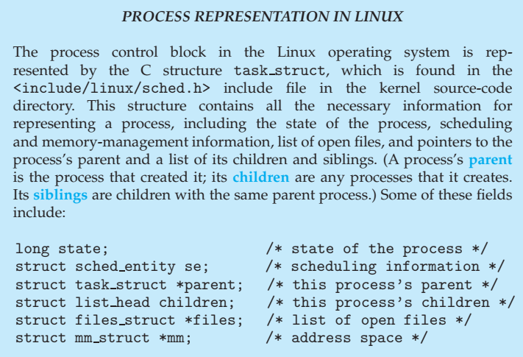

Slide 15
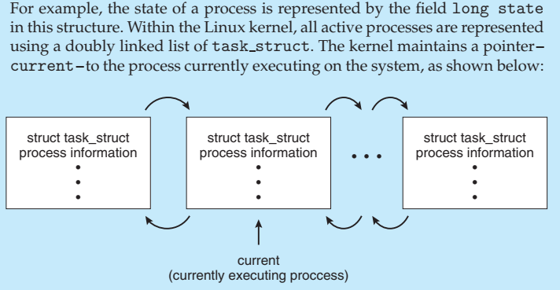

Slide 16
Process Scheduling
Maximize CPU use, quickly switch processes onto CPU for time sharing
Process scheduler selects among available processes for next execution on CPU
Maintains scheduling queues of processes:
Ready queue – set of all processes residing in main memory, ready and waiting to execute
Device queues – set of processes waiting for an I/O device
Job queue – set of all processes in the system
the CPU scheduler is to select from among the processes that are in the ready queue and allocate a CPU core to one of them
the CPU scheduler executes at least once every 100 milliseconds, although typically much more frequently

Slide 17
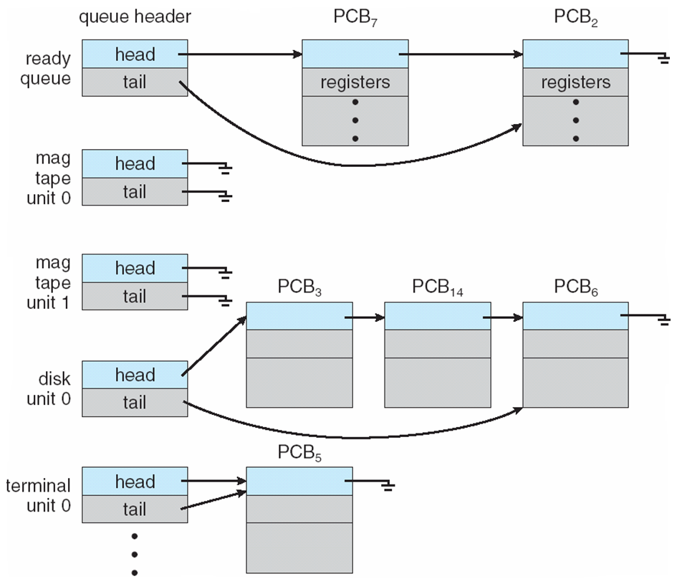
Ready Queue And Various I/O Device Queues

Slide 18
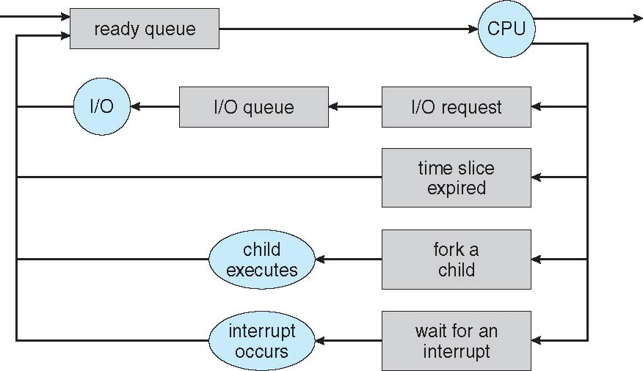
Representation of Process Scheduling

Slide 19
The process could issue an I/O request and then be placed in an I/O wait queue.
The process could create a new child process and then be placed in a wait queue while it awaits the child’s termination.
The process could be removed forcibly from the core, as a result of an interrupt or having its time slice expire, and be put back in the ready queue

Slide 20
Schedulers
Long-term scheduler (or job scheduler) – selects which processes should be brought into the ready queue
Short-term scheduler (or CPU scheduler) – selects which process should be executed next and allocates CPU
Sometimes the only scheduler in a system

Slide 21
Schedulers (Cont.)
Short-term scheduler is invoked very frequently (milliseconds) ⇒ (must be fast)
Long-term scheduler is invoked very infrequently (seconds, minutes) ⇒ (may be slow)
The long-term scheduler controls the degree of multiprogramming
Processes can be described as either:
I/O-bound process – spends more time doing I/O than computations, many short CPU bursts
CPU-bound process – spends more time doing computations; few very long CPU bursts

Slide 22
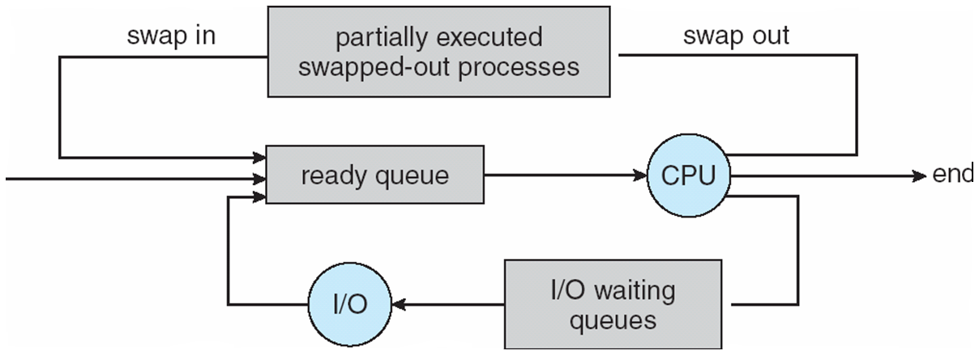
Addition of Medium Term Scheduling
Medium-term scheduler can be added if degree of multiple programming needs to decrease
Remove process from memory, store on disk, bring back in from disk to continue execution: swapping

Slide 23
Multitasking in Mobile Systems
Some mobile systems (e.g., early version of iOS) allow only one process to run, others suspended
Due to screen real estate, user interface limits iOS provides for a
Single foreground process- controlled via user interface
Multiple background processes– in memory, running, but not on the display, and with limits
Limits include single, short task, receiving notification of events, specific long-running tasks like audio playback

Slide 24
Context Switch
When CPU switches to another process, the system must save the state of the old process and load the saved state for the new process via a context switch.
state save and state restore
Context of a process represented in the PCB
Context-switch time is overhead; the system does no useful work while switching

Slide 25
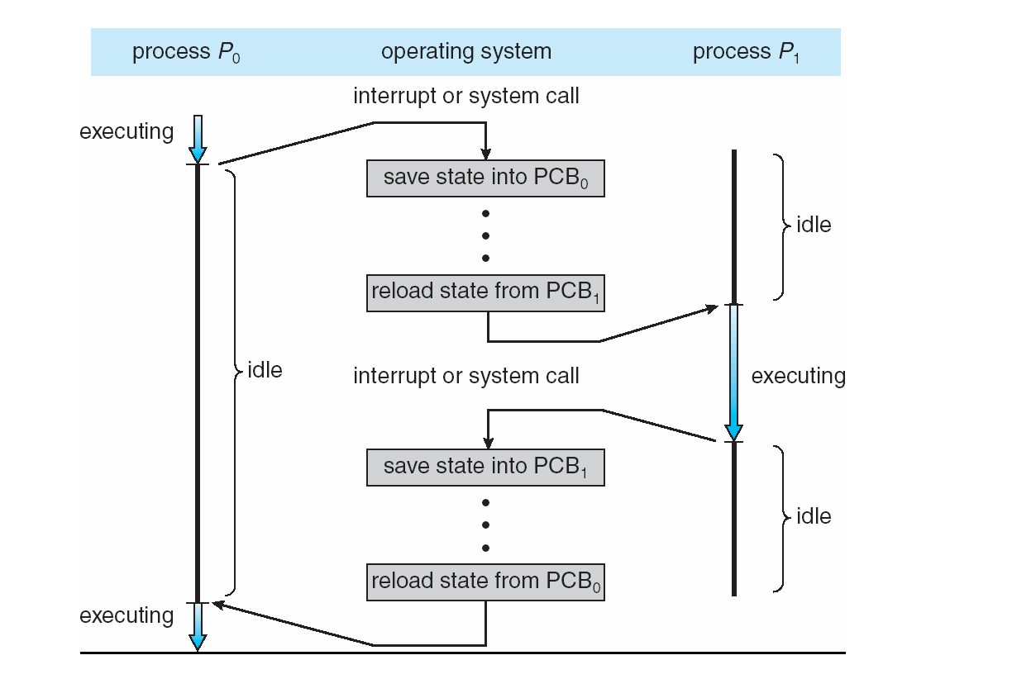
CPU Switch From Process to Process (Context Switching)

Slide 26
Operations on Processes: Process Creation
Parent process create children processes, which, in turn create other processes, forming a tree of processes
Generally, process identified and managed via a process identifier (pid)
Resource sharing Options
Parent and children share all resources
Children share subset of parent’s resource
Parent and child share no resources
Address space
Child duplicate of parent
Child has a program loaded into it

Slide 27
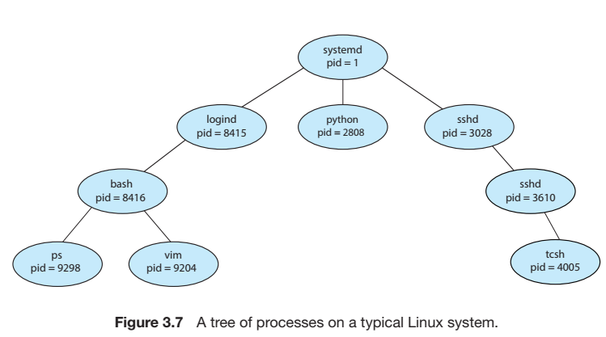

Slide 28
Process Creation (Cont.)
Execution Options
Parent and children execute concurrently
Parent waits until children terminate
UNIX examples
fork system call creates new process
exec system call used after a fork to replace the process’ memory space with a new program

Slide 29
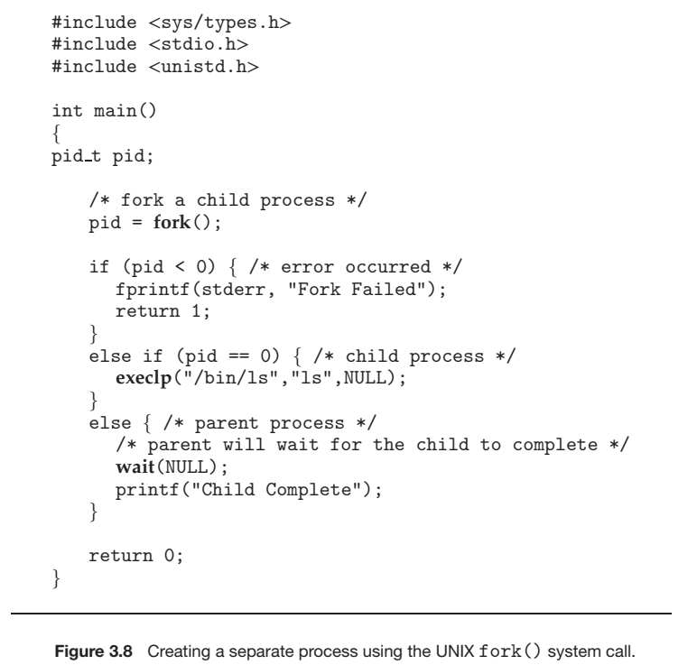

Slide 30
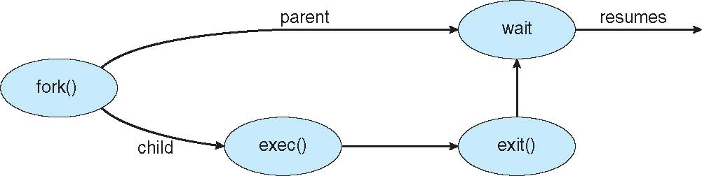
Process Creation

Slide 31
Operations on Processes : Process Termination
Process executes last statement and asks the operating system to delete it (exit)
Output data from child to parent (via wait)
Process’ resources are deallocated by operating system
Parent may terminate execution of children processes (abort)
Child has exceeded allocated resources
Task assigned to child is no longer required
If parent is exiting
Some operating system do not allow child to continue if its parent terminates
All children terminated - cascading termination

Slide 32
Operations on Processes : Process Termination
A parent process may wait for the termination of a child process by using the wait() system call.
The wait() system call is passed a parameter that allows the parent to obtain the exit status of the child
When a process terminates, its resources are deallocated by the operating system.
However, its entry in the process table must remain there until the parent calls wait()
A process that has terminated, but whose parent has not yet called wait(), is known as a zombie process

Slide 33
Operations on Processes : Process Termination
Now consider what would happen if a parent did not invoke wait() and instead terminated, thereby leaving its child processes as orphans

Slide 34
Interprocess Communication
Processes within a system may be independent or cooperating
Cooperating process can affect or be affected by other processes, including sharing data
Reasons for cooperating processes:
Information sharing
Computation speedup
Modularity
Convenience
Cooperating processes need interprocess communication (IPC)
Two models of IPC
Shared memory
Message passing

Slide 35
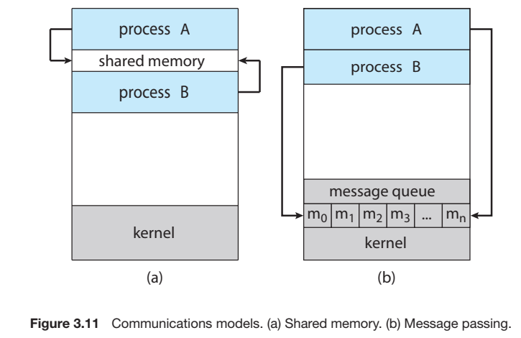

Slide 36
Cooperating Processes
Independent process cannot affect or be affected by the execution of another process
Cooperating process can affect or be affected by the execution of another process
Advantages of process cooperation
Information sharing
Computation speed-up
Modularity
Convenience

Slide 37
Producer-Consumer Problem
Paradigm for cooperating processes, producer process produces information that is consumed by a consumer process
unbounded-buffer places no practical limit on the size of the buffer
bounded-buffer assumes that there is a fixed buffer size

Slide 38
Bounded-Buffer – Shared-Memory Solution
Shared data
#define BUFFER_SIZE 10
typedef struct {
. . .
} item;
item buffer[BUFFER_SIZE];
int in = 0;
int out = 0;

Slide 39
Bounded-Buffer – Producer
while (true) { /* Produce an item */
while (((in = (in + 1) % BUFFER SIZE count) == out)
; /* do nothing -- no free buffers */
buffer[in] = item;
in = (in + 1) % BUFFER SIZE;
}

Slide 40
Bounded Buffer – Consumer
while (true) {
while (in == out)
; // do nothing -- nothing to consume
// remove an item from the buffer
item = buffer[out];
out = (out + 1) % BUFFER SIZE;
return item;
}

Slide 41
Interprocess Communication – Message Passing
Mechanism for processes to communicate and to synchronize their actions
IPC facility provides two operations:
send(message) – message size fixed or variable
receive(message)
If P and Q wish to communicate, they need to:
establish a communication link between them
exchange messages via send/receive
Implementation of communication link
physical (e.g., shared memory, hardware bus)
logical (e.g., logical properties)

Slide 42
Implementation Questions
How are links established?
Can a link be associated with more than two processes?
How many links can there be between every pair of communicating processes?
What is the capacity of a link?
Is the size of a message that the link can accommodate fixed or variable?
Is a link unidirectional or bi-directional?

Slide 43
Direct Communication
Processes must name each other explicitly:
send (P, message) – send a message to process P
receive(Q, message) – receive a message from process Q
Properties of communication link
Links are established automatically
A link is associated with exactly one pair of communicating processes
Between each pair there exists exactly one link
The link may be unidirectional, but is usually bi-directional

Slide 44
Indirect Communication
Messages are directed and received from mailboxes (also referred to as ports)
Each mailbox has a unique id
Processes can communicate only if they share a mailbox
Properties of communication link
Link established only if processes share a common mailbox
A link may be associated with many processes
Each pair of processes may share several communication links
Link may be unidirectional or bi-directional

Slide 45
Indirect Communication
Operations
create a new mailbox
send and receive messages through mailbox
destroy a mailbox
Primitives are defined as:
send(A, message) – send a message to mailbox A
receive(A, message) – receive a message from mailbox A

Slide 46
Indirect Communication
Mailbox sharing
P₁, P₂, and P₃ share mailbox A
P₁, sends; P₂ and P₃ receive
Who gets the message?
Solutions
Allow a link to be associated with at most two processes
Allow only one process at a time to execute a receive operation
Allow the system to select arbitrarily the receiver. Sender is notified who the receiver was.

Slide 47
Synchronization
Message passing may be either blocking or non-blocking
Blocking is considered synchronous
Blocking send has the sender block until the message is received
Blocking receive has the receiver block until a message is available
Non-blocking is considered asynchronous
Non-blocking send has the sender send the message and continue
Non-blocking receive has the receiver receive a valid message or null

Slide 48
Buffering
Queue of messages attached to the link; implemented in one of three ways
1. Zero capacity – 0 messages waiting in a queue.
2. Bounded capacity – finite length of n messages, n messages waiting in a queue
3. Unbounded capacity – infinite length ,any number of messages can wait in a queue

Slide 49
Examples of IPC Systems - POSIX
POSIX Shared Memory
Process first creates shared memory segment
segment id = shmget(IPC PRIVATE, size, S IRUSR | S IWUSR);
Process wanting access to that shared memory must attach to it
shared memory = (char *) shmat(id, NULL, 0);
Now the process could write to the shared memory
sprintf(shared memory, "Writing to shared memory");
When done a process can detach the shared memory from its address space
shmdt(shared memory);

Slide 50
Examples of IPC Systems - Mach
Mach communication is message based
Even system calls are messages
Each task gets two mailboxes at creation- Kernel and Notify
Only three system calls needed for message transfer
msg_send(), msg_receive(), msg_rpc()
Mailboxes needed for commuication, created via
port_allocate()

Slide 51
Examples of IPC Systems – Windows XP
Message-passing centric via local procedure call (LPC) facility
Only works between processes on the same system
Uses ports (like mailboxes) to establish and maintain communication channels
Communication works as follows:
The client opens a handle to the subsystem’s connection port object.
The client sends a connection request.
The server creates two private communication ports and returns the handle to one of them to the client.
The client and server use the corresponding port handle to send messages or callbacks and to listen for replies.

Slide 52
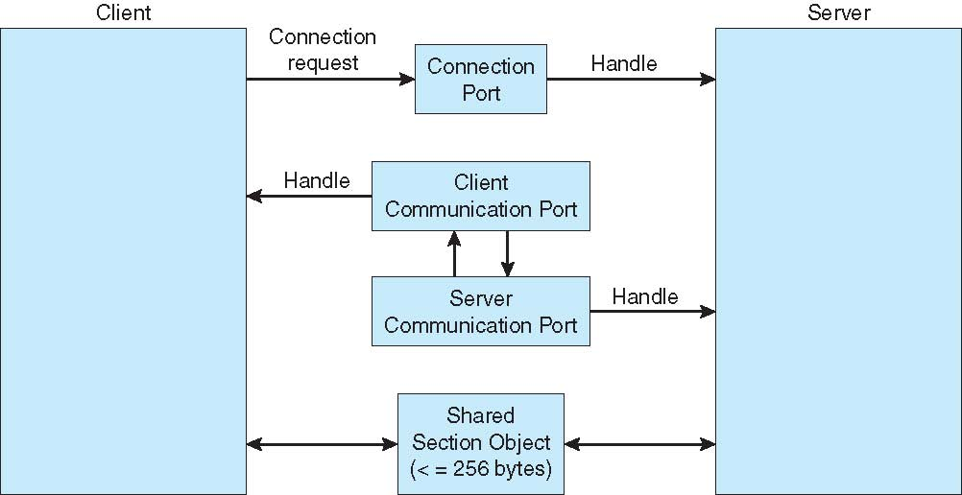
Local Procedure Calls in Windows XP

Slide 53
Communications in Client-Server Systems
Sockets
Remote Procedure Calls
Pipes

Slide 54
Sockets
A socket is defined as an endpoint for communication
Concatenation of IP address and port
The socket 161.25.19.8:1625 refers to port 1625 on host 161.25.19.8
Communication consists between a pair of sockets

Slide 55
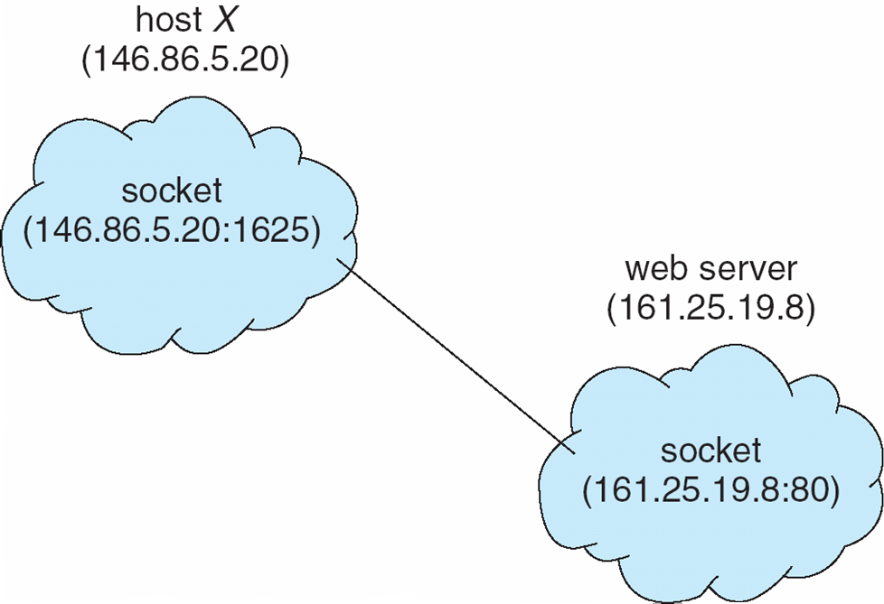
Socket Communication

Slide 56
Remote Procedure Calls
Remote procedure call (RPC) abstracts procedure calls between processes on networked systems
Stubs – client-side proxy for the actual procedure on the server
The client-side stub locates the server and marshalls the parameters
The server-side stub receives this message, unpacks the marshalled parameters, and performs the procedure on the server

Slide 57
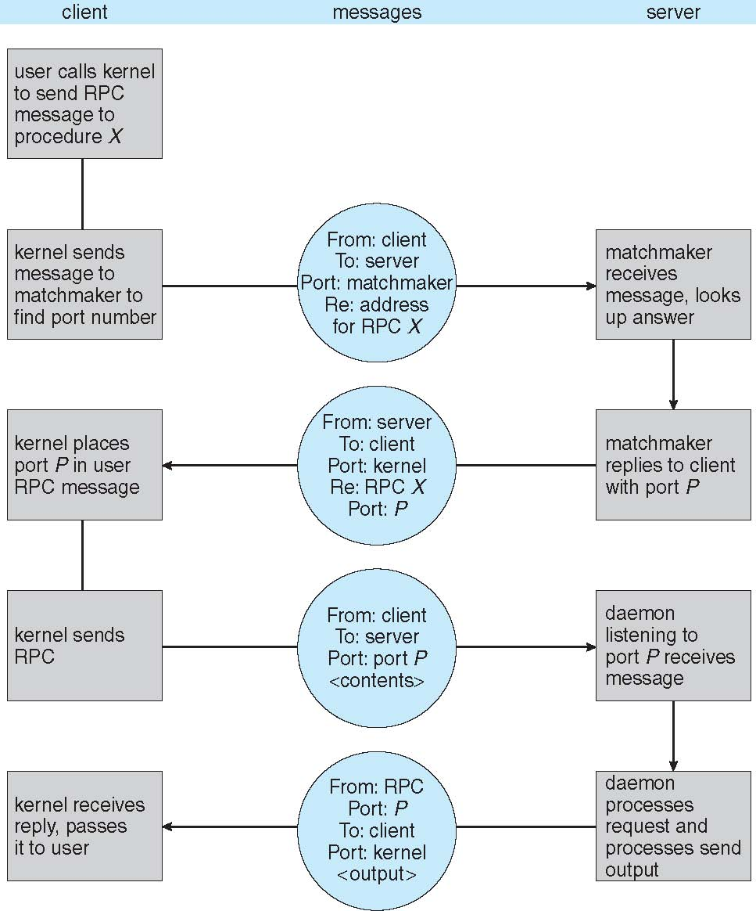
Execution of RPC

Slide 58
Pipes
Acts as a conduit allowing two processes to communicate
Issues
Is communication unidirectional or bidirectional?
In the case of two-way communication, is it half or full-duplex?
Must there exist a relationship (i.e. parent-child) between the communicating processes?
Can the pipes be used over a network?

Slide 59
Ordinary Pipes
Ordinary Pipes allow communication in standard producer-consumer style
Producer writes to one end (the write-end of the pipe)
Consumer reads from the other end (the read-end of the pipe)
Ordinary pipes are therefore unidirectional
Require parent-child relationship between communicating processes

Slide 60
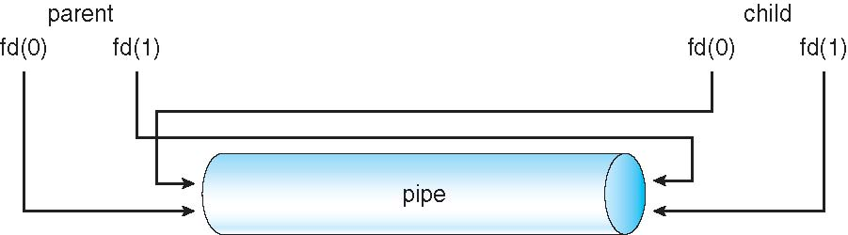
Ordinary Pipes

Slide 61
Named Pipes
Named Pipes are more powerful than ordinary pipes
Communication is bidirectional
No parent-child relationship is necessary between the communicating processes
Several processes can use the named pipe for communication
Provided on both UNIX and Windows systems

Slide 62
FIFO Example
// C program to implement one side of FIFO // This side writes first, then reads #include <stdio.h> #include <string.h> #include <fcntl.h> #include <sys/stat.h> #include <sys/types.h> #include <unistd.h> int main() { int fd; // FIFO file path char * myfifo = "/tmp/myfifo"; // Creating the named file(FIFO) // mkfifo(<pathname>, <permission>) mkfifo(myfifo, 0666); char arr1[80], arr2[80]; while (1) { // Open FIFO for write only fd = open(myfifo, O_WRONLY); // Take an input arr2ing from user. // 80 is maximum length fgets(arr2, 80, stdin); // Write the input arr2ing on FIFO // and close it write(fd, arr2, strlen(arr2)+1); close(fd); // Open FIFO for Read only fd = open(myfifo, O_RDONLY); // Read from FIFO read(fd, arr1, sizeof(arr1)); // Print the read message printf("User2: %s\n", arr1); close(fd); } return 0; }
// C program to implement one side of FIFO // This side reads first, then reads #include <stdio.h> #include <string.h> #include <fcntl.h> #include <sys/stat.h> #include <sys/types.h> #include <unistd.h> int main() { int fd1; // FIFO file path char * myfifo = "/home/arahman/os_week04/myfifo"; // Creating the named file(FIFO) // mkfifo(<pathname>,<permission>) mkfifo(myfifo, 0666); char str1[80], str2[80]; while (1) { // First open in read only and read fd1 = open(myfifo,O_RDONLY); read(fd1, str1, 80); // Print the read string and close printf("User1: %s\n", str1); close(fd1); // Now open in write mode and write // string taken from user. fd1 = open(myfifo,O_WRONLY); fgets(str2, 80, stdin); write(fd1, str2, strlen(str2)+1); close(fd1); } return 0; }
Notes:
// C program to implement one side of FIFO
// This side writes first, then reads
#include <stdio.h>
#include <string.h>
#include <fcntl.h>
#include <sys/stat.h>
#include <sys/types.h>
#include <unistd.h>

Slide 63
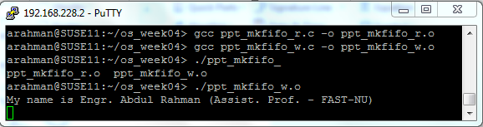
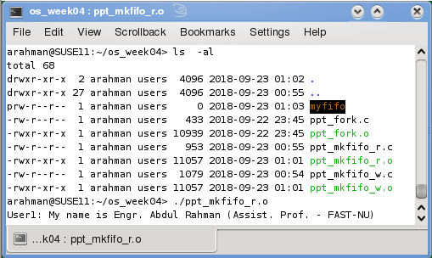
FIFO Example
Notes:
https://www.geeksforgeeks.org/named-pipe-fifo-example-c-program/

